Slide 1
RouteMe

Slide 2
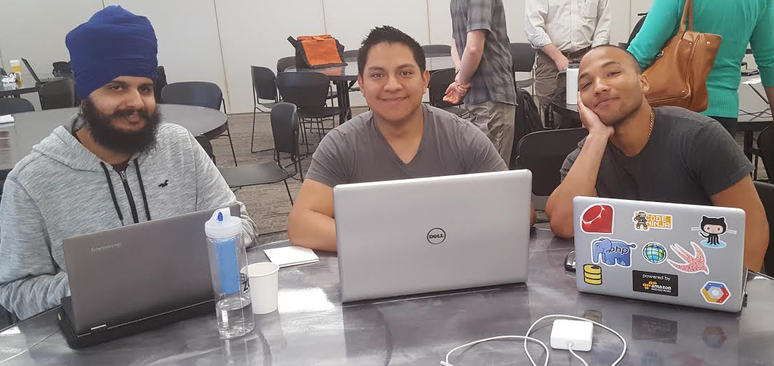
Team
Manvir Singh Audrey Chavarria Kevia Cloud

Slide 3
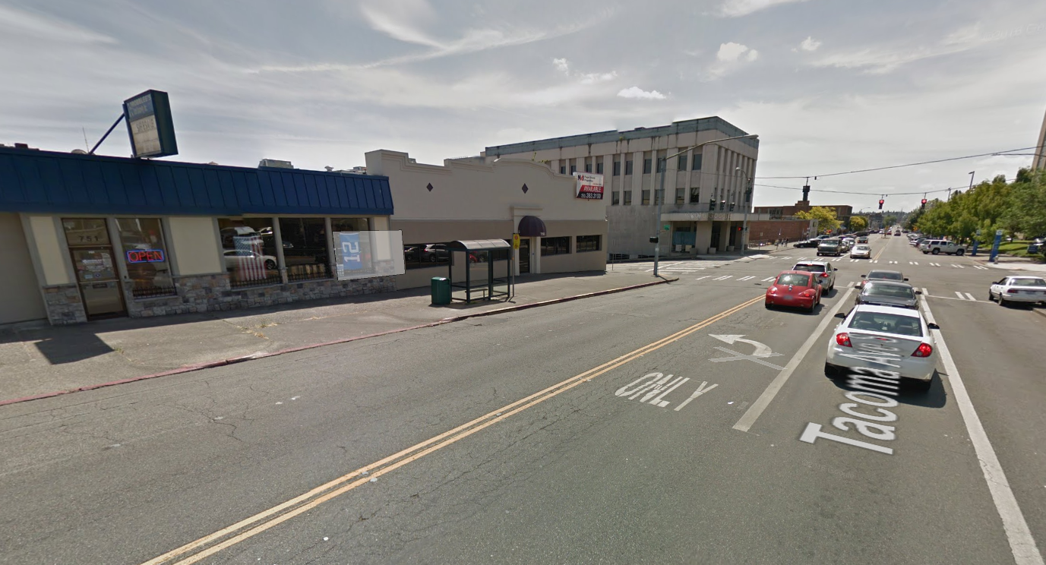
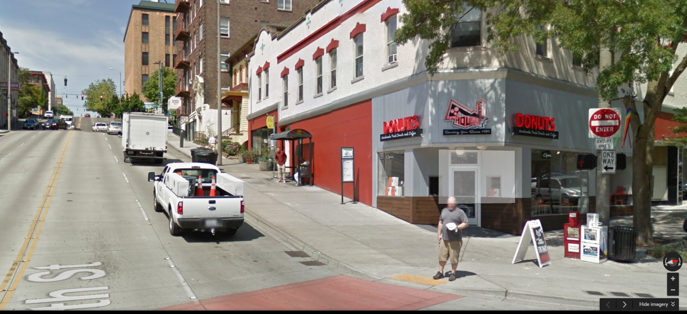
Problem encountered
When a person in a wheelchair want to use public transportation to travel to a destination they never know what their drop off location will be like:
Flat Surface
Steep Surface
Accessible
Not Accessible

Slide 4
Our idea
We wanted to build an app and web service that would help people identify the accessibility of their destination and whether they could use bus transportation or a shuttle

Slide 5
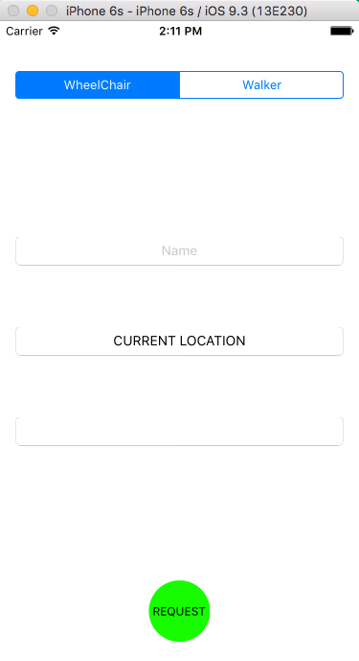
Our prototype
User lets us know if they are in a wheel chair or not
User provides their name
We identify their current location
User provides their final destination

Slide 6
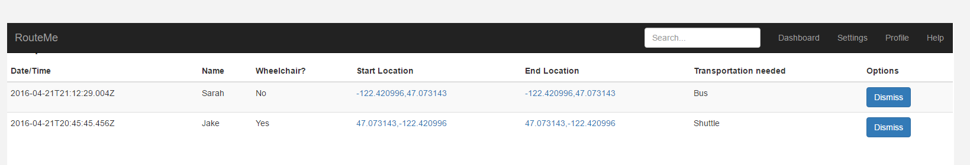
The secret formula
Our algorithm will let us determine what is best for the user:
Taking public transportation or a shuttle
Our automated system will provide possible times and routes to take
We will also connect them with shuttle providers

Slide 7
Recommendations
For the City of Tacoma & Pierce Transit

